Slide 1

CAPSTONE PROJECT REVIEW 3 STOCK MARKET PREDICTION USING MACHINE LEARNING
Name : Arnab Karmakar
Register No:19BAI1090
Programme & Specialization : B.Tech CSE specialisation in AI and ML
Guide Name:
Dr Anita X.

Slide 2
Outline
Introduction
Abstract
Problem Statement
Research Challenges
Research Objective
Proposed System
Proposed System Diagram
Methodology
List of modules
Explanation of all the modules one by one which includes the Algorithm
Implementations
What is to be done next
Research Paper Status
Guide Approval mail snapshot
References

Slide 3
INTRODUCTION
Stocks are the most famous asset class for investment purposes.
Returns are generated through capital appreciation or dividend payments in the stock market.
It is important to correctly select the stock that you will invest in, in order to generate a positive return.
In order to generate a positive return, one must be able to predict the price security should hold in the future and invest/choose not to invest in it based on its price.

Slide 4
AI is playing a major role in many important decisions making, models, investments, etc.
This project aims to build an AI-based model that will help select stocks for investment purposes.
For correct prediction, we will be giving out promoter buying data combined with other attributes of the company.
The rationale being a promoter is the best judge of the company and will not buy a substantial amount of stock if he doesn`t expect it to do well in the future.

Slide 5
ABSTRACT
The financial exchange is one of the basic areas of a nation’s economy.
The brain network is one of the smart information mining procedures that has been involved by analysts in different regions for the beyond 10 years.
The different calculations utilized for gauging can be sorted into direct (AR, MA, ARIMA, ARMA) and non-straight models (ARCH, GARCH, Neural Network).

Slide 6
Yet, this likewise intends that there’s a ton of information to track down designs in.
Thus, monetary investigators, specialists, and information researchers continue to investigate examination procedures to distinguish securities exchange patterns.
This led to the idea of algorithmic exchanging, which utilizations computerized, pre-modified exchanging techniques to execute orders.
I’ll utilize both conventional quantitative money system and AI calculations to foresee stock developments.

Slide 7
PROBLEM STATEMENT
The most significant obstacle was removing and handling authentic information from insider trading.
We in like manner expected to eliminate the genuine characteristics of associations that were relevant at the hour of buying.
It was difficult to scrap data through different regions especially stock-related objections as there is a great deal of worthless information open, picking the one you truly need is really irksome.
Finding the regions which contain the information you need is another troublesome task.
The development that ought to have been made relied upon money related speculation.
We expected to choose questions like what time spans should be consolidated, should there be a benchmark rate, and if for sure, what should be the benchmark rate for different periods of time?

Slide 8
RESEARCH CHALLENGES
Managing the data included filtering the data to only include relevant data, and amalgamating the various transactions company-wise in the monthly time frame to make the data fit for training.
We also had to extract the historical attributes of companies that were relevant at the time of buying.
It was difficult to scrap data through different sites especially stock-related sites as there is too much useless information available, picking the one you need is really difficult.
Finding the sites which contain the information you need is another challenging task.
Once we had the filtered promoter buying data and attributes of the company, we needed to decide on the structure of the model.

Slide 9
Research Objective
The goal of using machine learning for stock market prediction is to create a model that can predict future stock prices or market trends using historical data and machine learning algorithms.
It is to improve the accuracy of predictions and help investors make more informed investment decisions.
Keep in mind that stock market predictions are not guaranteed and to consider external factors such as the economy, industry trends, and geopolitical events while investing.

Slide 10
Proposed System
The system would need to collect historical data on stock prices, market indicators, and other relevant information in order to make predictions.
It would then need to select the most relevant features for making predictions, such as stock prices, market indicators, and sentiment scores.
The system would need to train a model on pre-processed data, using supervised or unsupervised learning methods.
The system would then need to evaluate the performance of the model using a variety of metrics.
Finally, the system would need to deploy the model in a production environment to make predictions for real-world stock market scenarios.

Slide 11
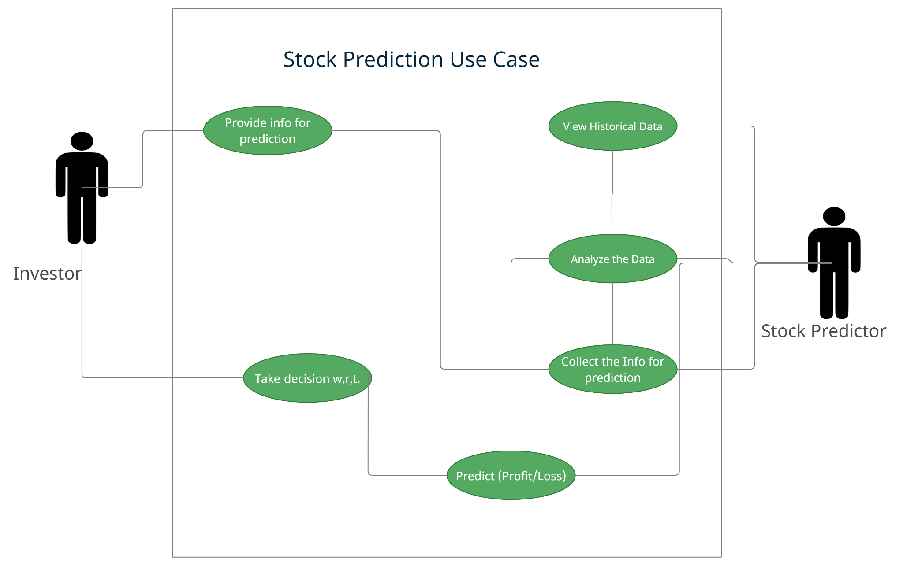
Proposed System Diagram
USE-CASE DIAGRAM

Slide 12
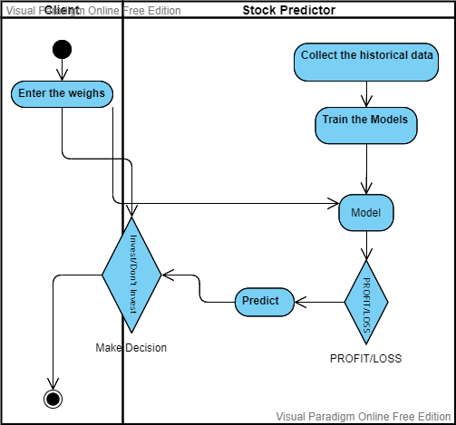
ACTIVITY DIAGRAM

Slide 13
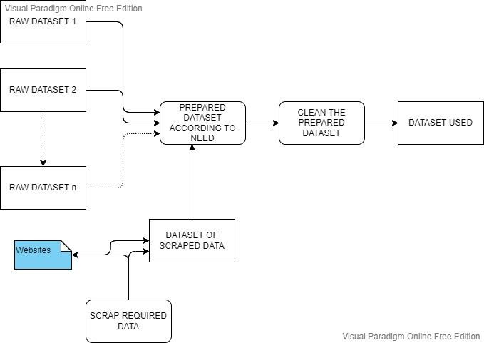
SYSTEM ARCHITECTURE
The data is collected from various websites as per our project goal in order to get better results, since the data collected was very raw, thus we processed it, and cleaned it.

Slide 14
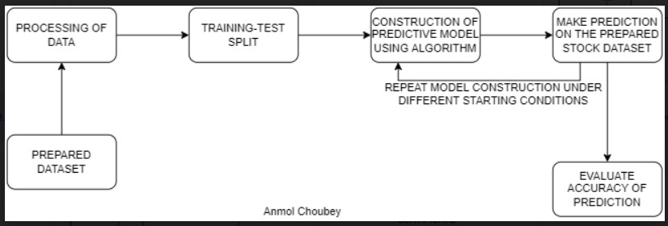
MODEL DEVELOPMENT ARCHITECTURE

Slide 15
METHODOLOGY
The project will use the agile methodology to speed up the process and prioritize tasks in order to ensure that the most important goals are met.
This methodology follows four principles: focusing on the needs of the users, working with them closely, responding to changes, and using a fast approach.

Slide 16
List of Modules
SUPERVISED AND UNSUPERVISED LEARNING
DECISION TREE
SVM (Support Vector Machine)
RANDOM FOREST
NEURAL NETWORK
ACTIVATION FUNCTION
LSTM
WEB SCRAPING

Slide 17
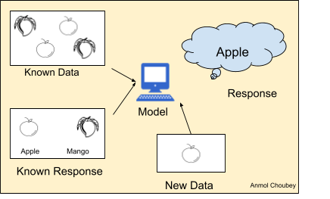
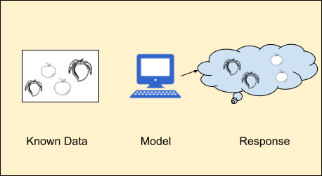
Explanation of Modules
SUPERVISED LEARNING
The machine learning model is supervised, meaning that it is based on a dataset that includes labeled data, which tells the machine what the desired response or target value is.
UNSUPERVISED LEARNING
Unsupervised learning is when a machine uses unlabeled data to learn on its own without any human intervention. The computer looks for patterns in unlabeled data and responds with a response based on its own pattern finding.

Slide 18
Contd.
DECISION TREE
A decision tree is a flowchart-like tree structure in which each internal node represents an attribute test, each branch represents the test`s conclusion, and each leaf node stores a class label.
SVM (Support Vector Machine)
The amount of characteristics accessible determines the size of the hyperplane.
The hyperplane is essentially a line if there are only features. The hyperplane becomes a two-dimensional plane when the number of features reaches three.

Slide 19
Contd.
RANDOM FOREST
A fundamental difference between decision trees and random forests is that feature bagging gives a random selection of features, guaranteeing little connection among decision trees.
Because it uses both bagging and feature randomization to produce an uncorrelated forest of decision trees, the random forest methodology is an extension of the bagging method.
NEURAL NETWORK
A neural network is a Deep Learning model based on how neurons and brains operate in humans.
LSTM
LSTM networks are a sort of recurrent neural network that may learn order dependency in sequence prediction issues.

Slide 20
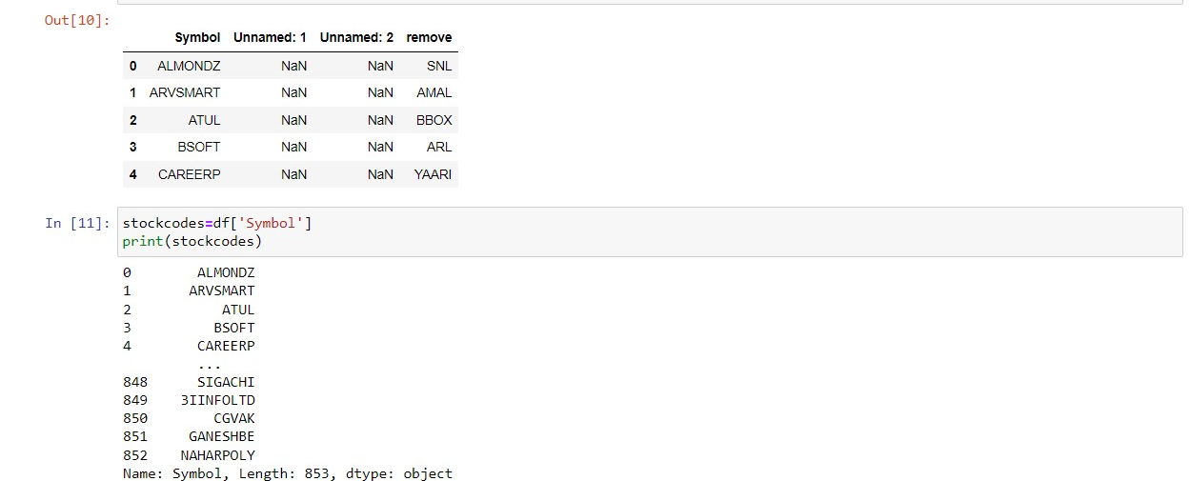
Implementation & Results
WEB SCRAPING
Web scraping was used to collect data, including unique stock codes or tokens, from various sources.
The collected data was matched with stock names to create a comprehensive dataset for stock prediction.
Knowing the industry type is crucial for making accurate predictions, as different industries are affected differently by market disturbances.

Slide 21
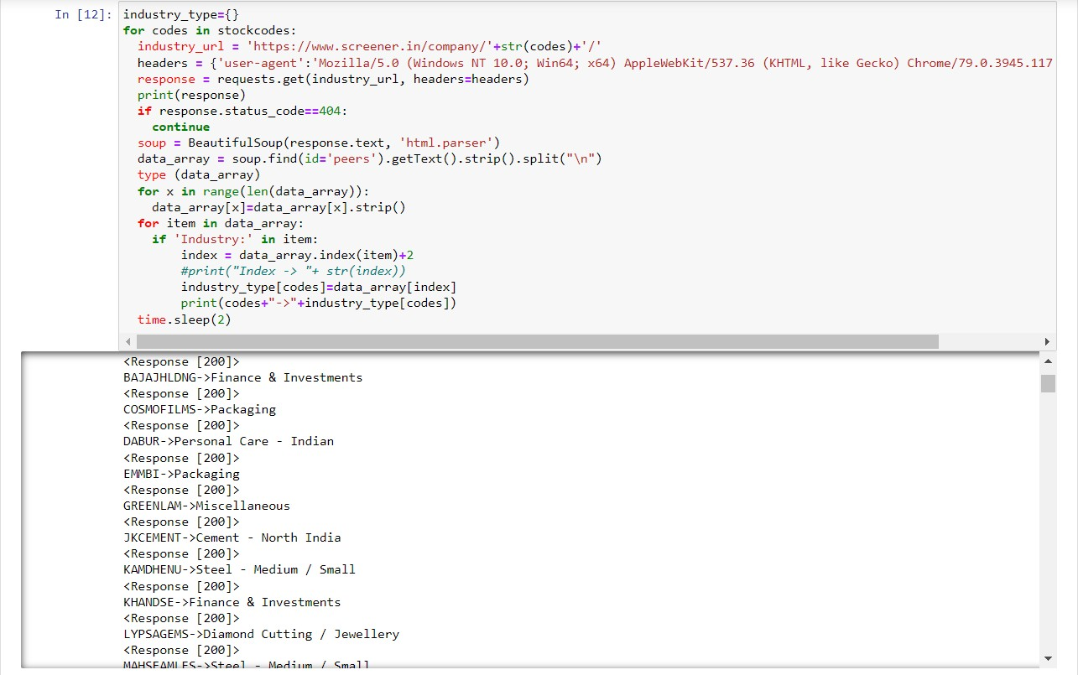
Industry Type scraping
df.drop('Symbol',axis=1,inplace=True)
c={'SmallCap':0,'MidCap':1,'LargeCap':2}
df['Cap']=df['Cap'].map(c)
i={}
count=0
for _ in df['Industry']:
if _ not in i:
i[_]=count
count+=1
df['Industry']=df['Industry'].map(i)
r={'PROFIT':1,'LOSS':0}
df['Result15']=df['Result15'].map(r)

Slide 22
DATA PREPARATION
The insider trading data was extracted from the NSE website and filtered to remove irrelevant transactions using Excel.
The transactions of the same company in the same month were amalgamated and net selling positions were removed.
Google finance function and web scraping were used to extract other attributes of the stock, which were placed correctly using various Excel functions.
Various machine learning algorithms used in the project are logistic regression, decision tree, support vector machine, random boost classifier, k-Neighbor classifier, perceptron, and SGDclassifier.
These algorithms were applied to different time frames (2 months, 6 months, 9 months, and 12 months) and with alpha return Benchmarks of 5%, 10%, 13%, and 15%.
A "max" dataset was created to avoid biased training of the model caused by entries that were profitable in some time frames but marked as losses in others.

Slide 23
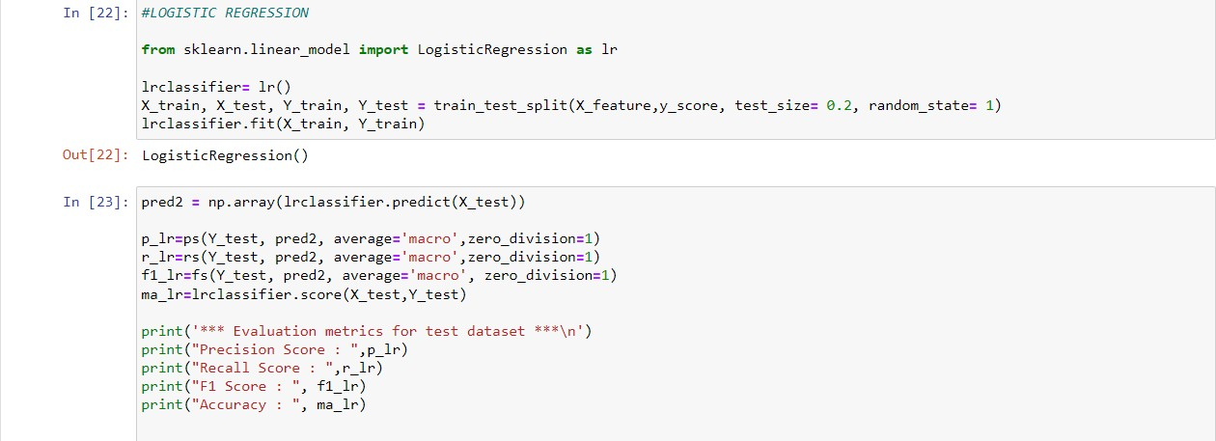
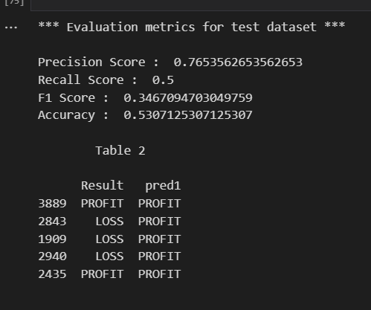
Usage Of MACHINE LEARNING

Slide 24
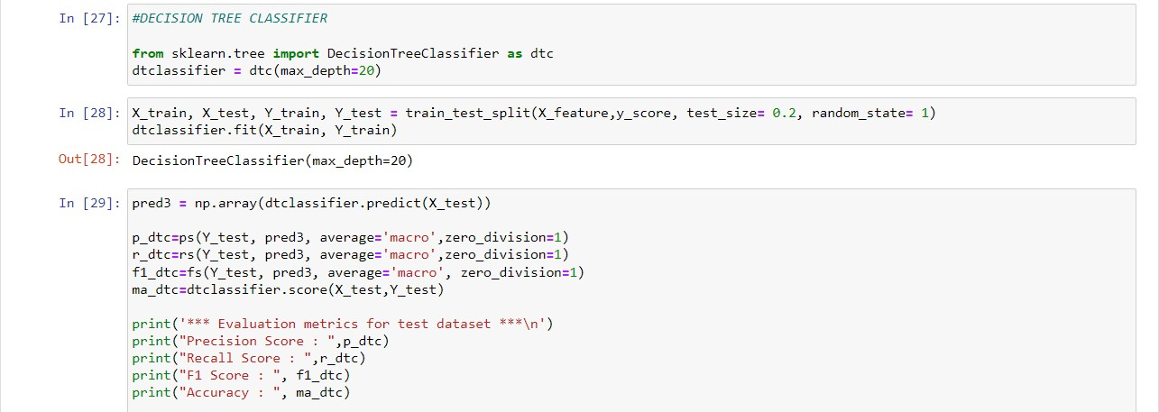
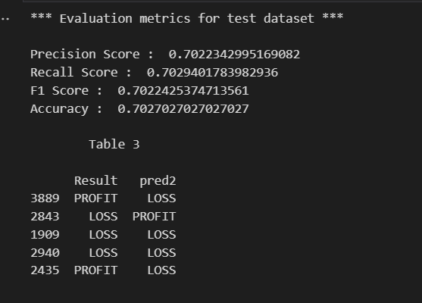

Slide 25
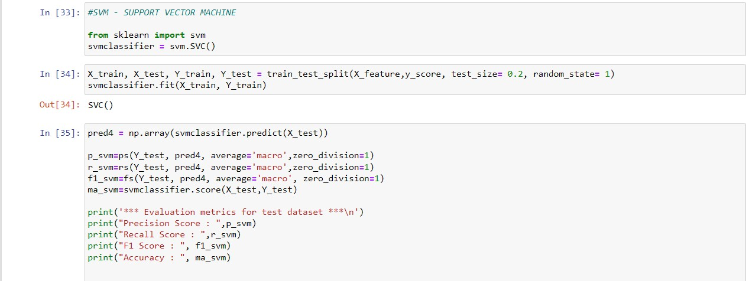
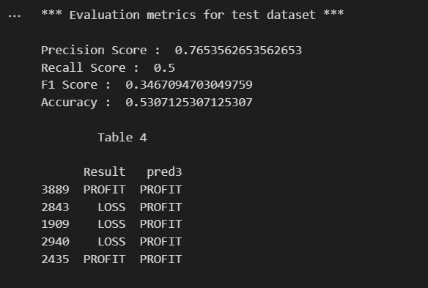

Slide 26
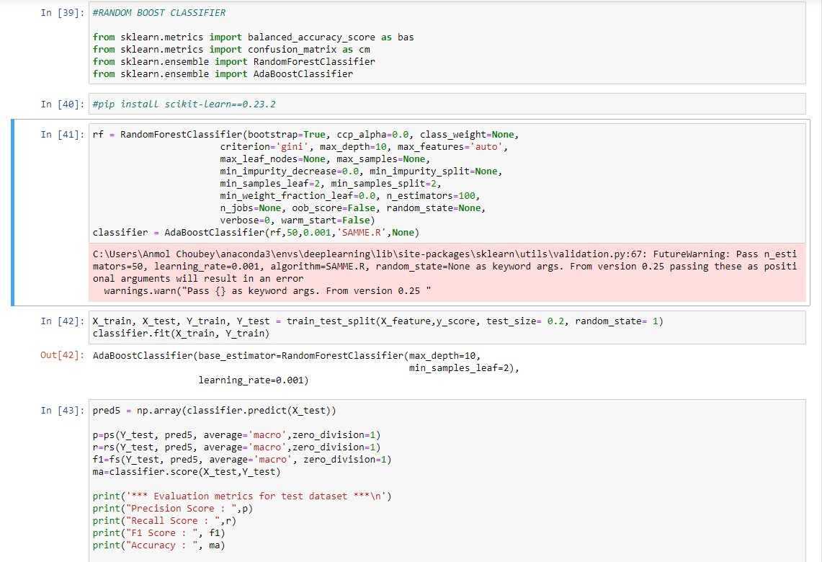
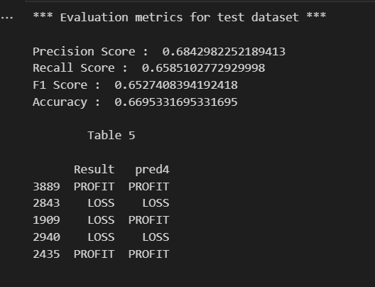

Slide 27
ACCURACY OF MACHINE LEARNING ALGORITHMS
The most important aspect of prediction is accuracy i.e., how much accuracy the algorithm is giving. On the basis of that decision-making of investing in the stocks will take place.
Algorithms | Result (Accuracy) | Result with the Benchmark (Accuracy)
Logistic Regression | 54.65 | 57
Decision Tree | 62.77 | 63.21
SVM | 56.30 | 58.77
Random Boost | 63.60 | 67.25
K-Neighbor | 52.88 | 56.41
Perceptron | 56.41 | 41.22
SGD Classifier | 56.85 | 58.30
Table 1 Machine Learning Algorithm 2 months holding period accuracy

Slide 28
Algorithms | Result (Accuracy) | Result with the Benchmark (Accuracy)
Logistic Regression | 53.07 | 58.4
Decision Tree | 70.27 | 71.00
SVM | 53.85 | 58.72
Random Boost | 66.95 | 76.65
K-Neighbor | 53.45 | 55.89
Perceptron | 53.68 | 53.31
SGD Classifier | 46.92 | 49.78
Table 2 Machine Learning Algorithm 6 months holding period accuracy

Slide 29
Algorithms | Result (Accuracy) | Result with the Benchmark (Accuracy)
Logistic Regression | 55.34 | 54.83
Decision Tree | 75.31 | 77.48
SVM | 55.34 | 55.21
Random Boost | 79.26 | 80.66
K-Neighbor | 57.76 | 55.72
Perceptron | 44.65 | 47.54
SGD Classifier | 55.85 | 55.47
Table 3 Machine Learning Algorithm 9 months holding period accuracy

Slide 30
Algorithms | Result with 15% Benchmark (Accuracy)
Logistic Regression | 53.32
Decision Tree | 75.20
SVM | 52.99
Random Boost | 78.93
K-Neighbor | 53.64
Perceptron | 47.32
SGD Classifier | 52.99
Table 5 Machine Learning Algorithms max (dataset) accuracy

Slide 31
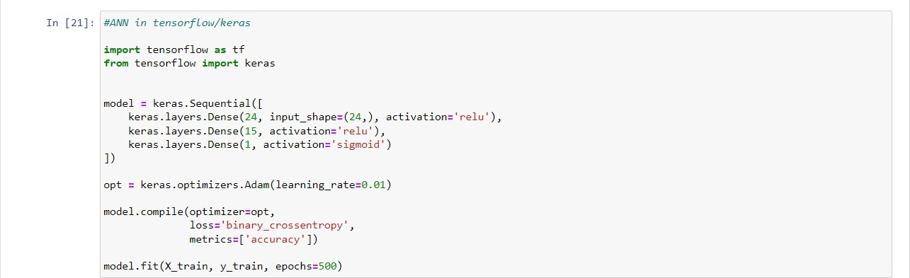
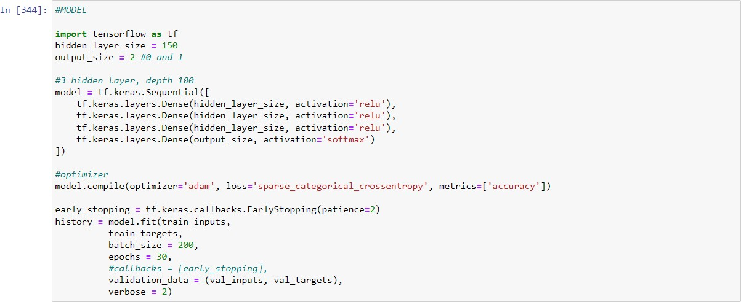
DEEP LEARNING ALGORITHMS
ANN has input, hidden, and output layers
The data is passed through the input layer, processed through the hidden layer, and the output is obtained from the output layer
ANN can be trained using historical stock data
ANN
2. CNN

Slide 32
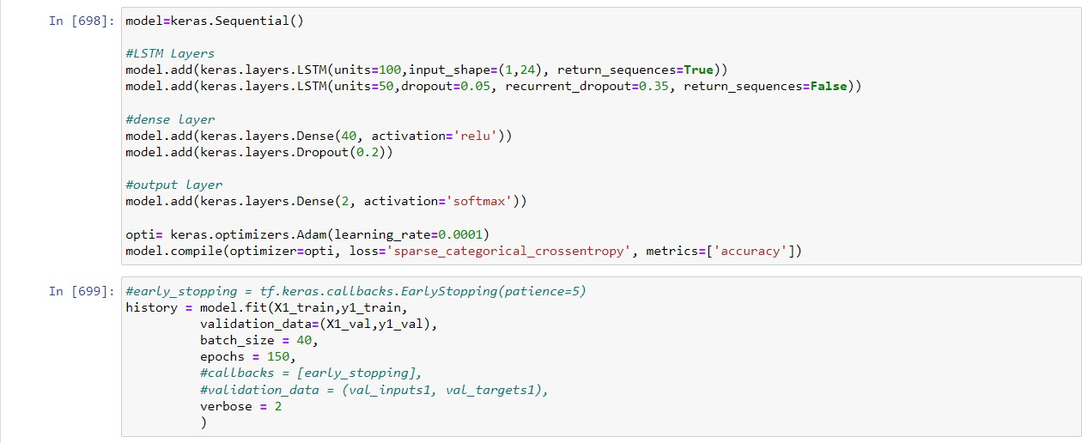
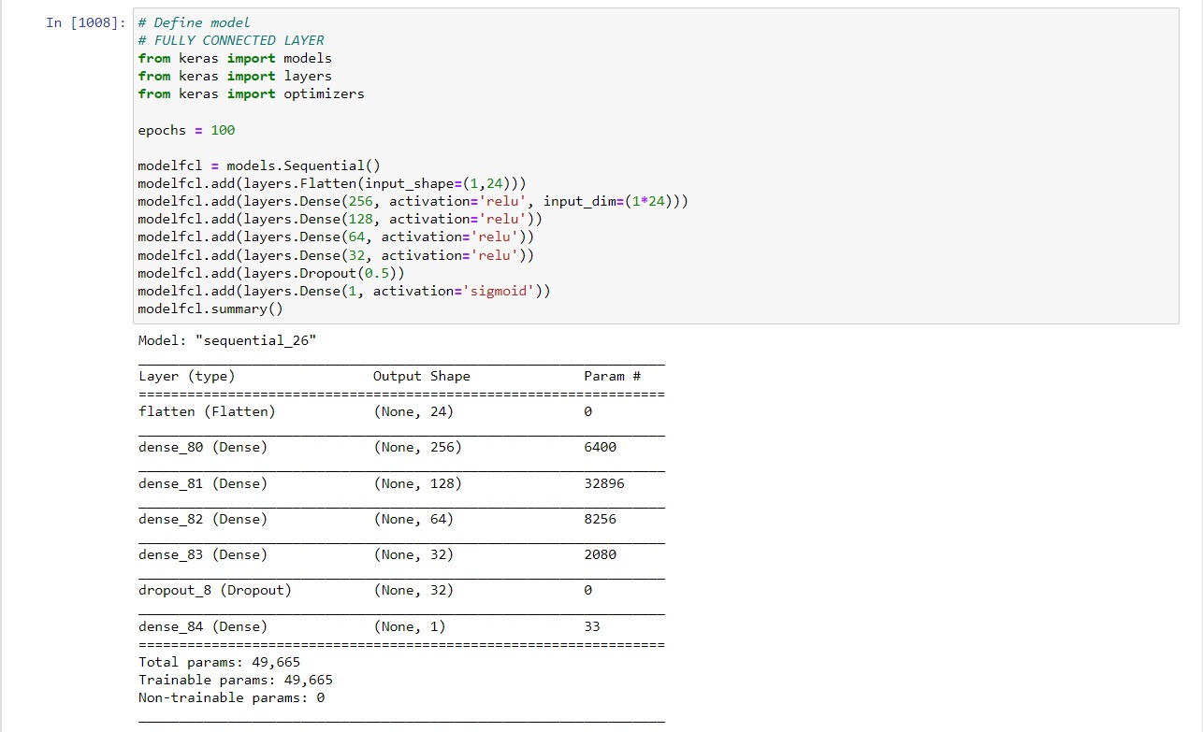
3. LSTM
4. FULLY CONNECTED LAYER

Slide 33
ACCURACY OF DEEP LEARNING ALGORITHMS
ANN
Months (Holding Period) | Result (Accuracy) | Result with Benchmarks (Accuracy)
2 months | 70.20 | 68.56
6 months | 75.42 | 75.45
9 months | 76.08 | 78.62
12 months | 78.49 | 78.29
max | 78.44 (15% Benchmark) | -
CNN
Months (Holding Period) | Result (Accuracy) | Result with Benchmarks (Accuracy)
2 months | 67.61 | 68.90
6 months | 72.48 | 75.18
9 months | 78.24 | 80.03
12 months | 77.50 | 76.01
max | 78.44 (15% Benchmark) | -

Slide 34
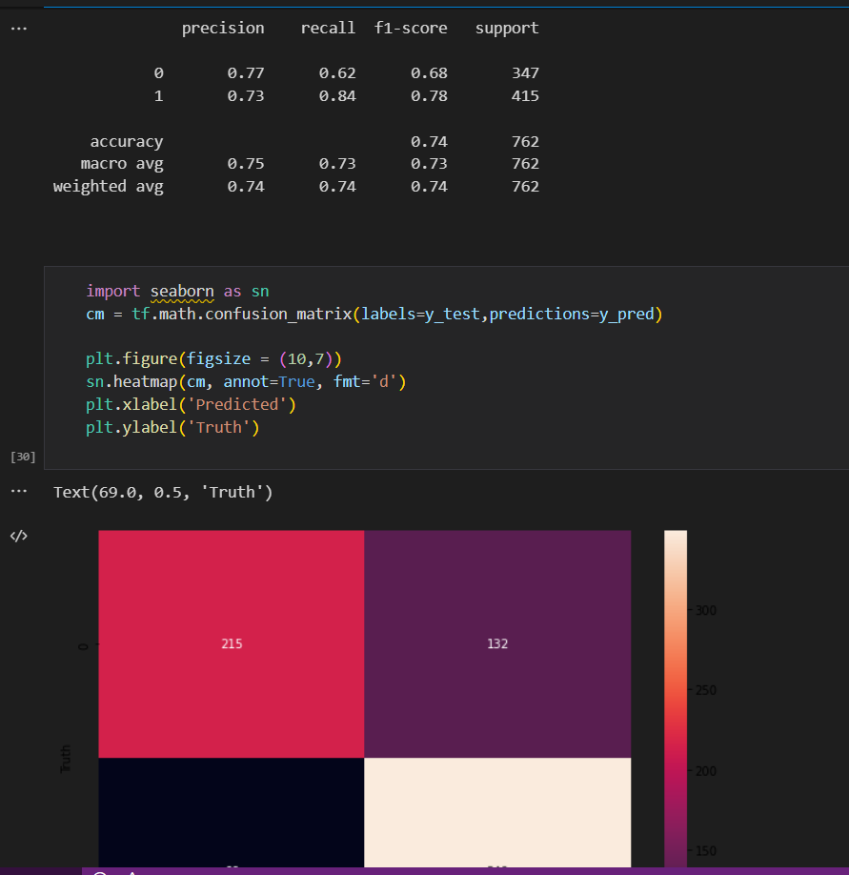
Confusion Matrix
The confusion matrix is a tool used to evaluate the performance of a machine learning model.
It provides information about the true positive, true negative, false positive, and false negative rates of the model's predictions.

Slide 35
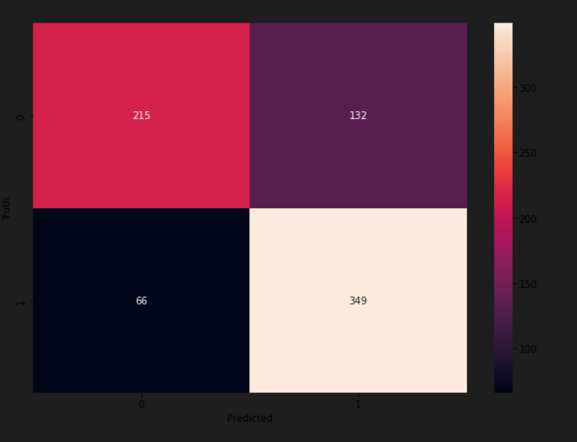
In stock market prediction, the confusion matrix can be used to determine how well the model is performing in terms of predicting profitable and unprofitable trades.
The true positive rate indicates the percentage of profitable trades that the model correctly predicted, while
from sklearn.metrics import confusion_matrix , classification_report
print(classification_report(y_test,y_pred))

Slide 36
RESULTS
Project achieved its goals by creating machine learning and deep learning models to aid investment decisions.
Models accurately predicted which stocks to buy with varying accuracy levels.
Promoter buying data helped create successful portfolio.
Benchmarks positively impacted portfolio return.
Most algorithms performed well, with FULLY CONNECTED LAYER performing the best

Slide 37
What is to be done next
Complete some of the implementation of the proposed method.
Aim to achieve a good accuracy and precision through the dataset provided.

Slide 38
Research Paper Status
Completed the research paper with Introduction, Literature Survey, Machine Learning, Deep Learning, System Design and Methodology, Implementation, Conclusion.
Just a bit of finalising is left with prediction model.

Slide 39
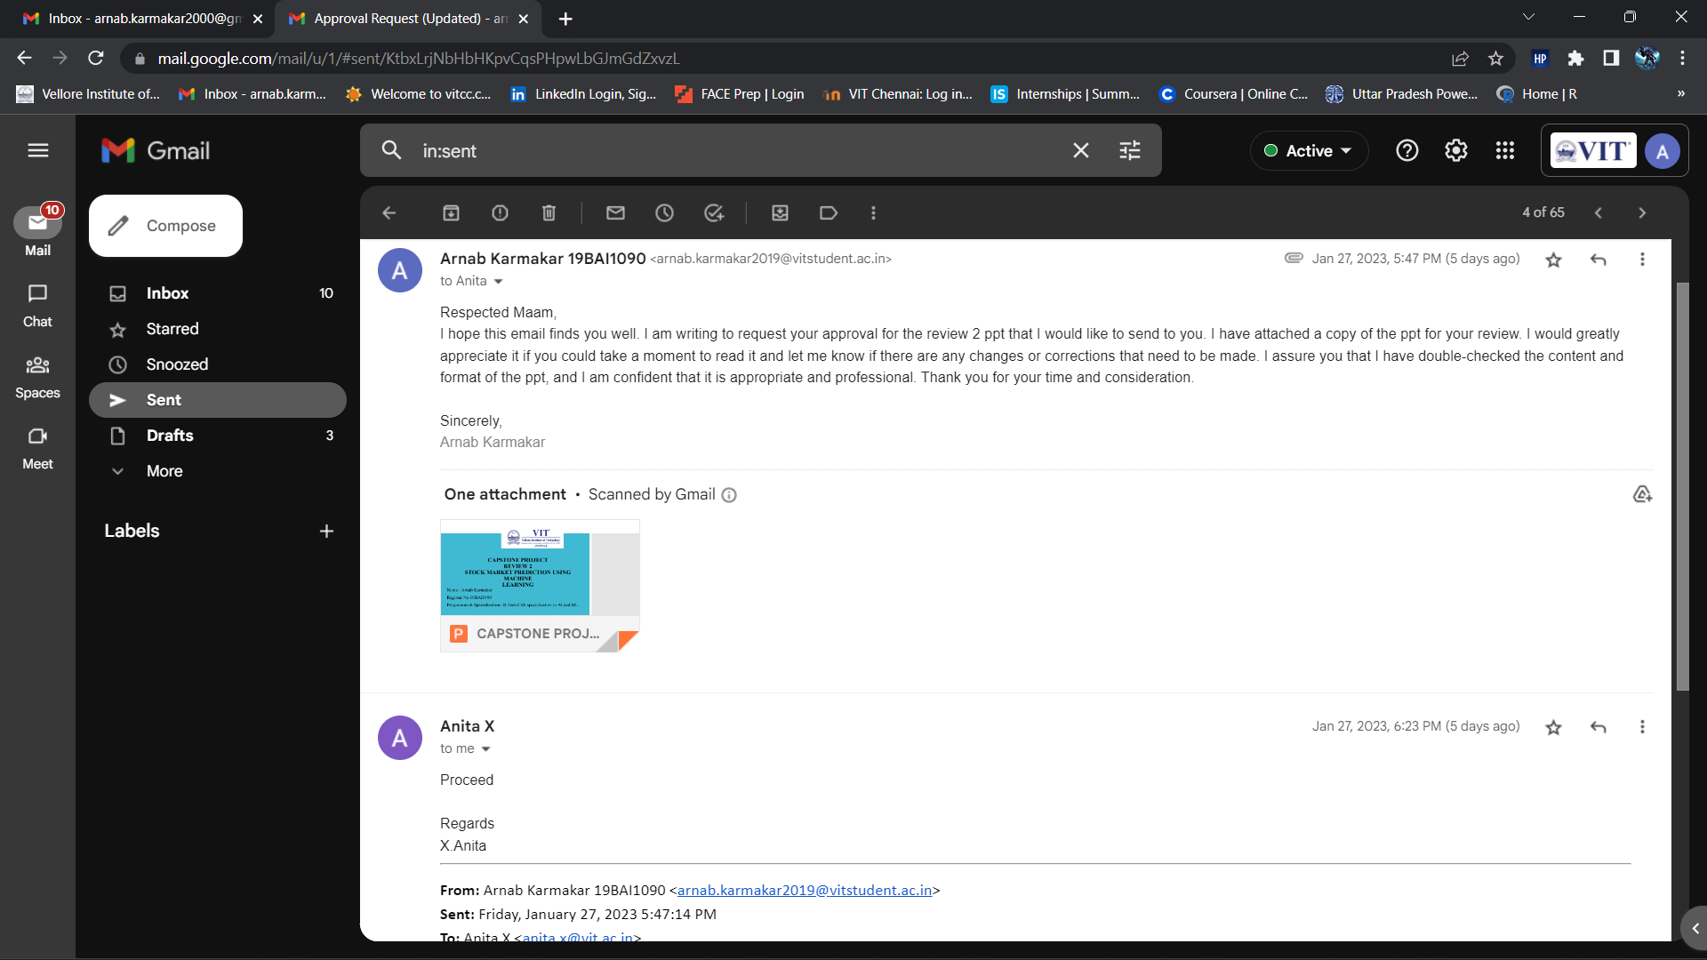
Guide Approval mail snapshot

Slide 40
References
Naik, N., Mohan, B.R. Intraday Stock Prediction Based on Deep Neural Network. Natl. Acad. Sci. Lett. 43, 241–246 (2020).
Pang, X., Zhou, Y., Wang, P. et al. An innovative neural network approach for stock market prediction. J Supercomput 76, 2098–2118 (2020).
Kohli P.P.S., Zargar S., Arora S., Gupta P. (2019) Stock Prediction Using Machine Learning Algorithms. In: Malik H., Srivastava S., Sood Y., Ahmad A. (eds) Applications of Artificial Intelligence Techniques in Engineering. Advances in Intelligent Systems and Computing, vol 698. Springer, Singapore.
Ye, Q. and Wei, L. (2015) The Prediction of Stock Price Based on Improved Wavelet Neural Network. Open Journal of Applied Sciences, 5, 115-120.
Kolasani, S. and Assaf, R. (2020) Predicting Stock Movement Using Sentiment Analysis of Twitter Feed with Neural Networks. Journal of Data Analysis and Information Processing, 8, 309-319.
https://doi.org/10.1186/s40537-020-00333-6
Keras URL https://keras.io/
TensorFlow URL https://www.tensorflow.org/tutorials
Safer, A.M., The application of neural networks to predict abnormal stock returns using insider trading data. Applied Stochastic Models in Business and Industry, 18(4), pp.381-389.
Sadia, K.H., Sharma, A., Paul, A., Padhi, S. and Sanyal, S., 2019. Stock market prediction using machine learning algorithms. Int. J. Eng. Adv. Technol, 8(4), pp.25-31.
Deep Learning URL https://www.deeplearning.ai/
Kuhn, Max and Johnson, Kjell. Applied Predictive Modeling. Springer. 2013
Lakonishok, Josef, and Inmoo Lee, 2001, Are insider trades informative? Review of Financial Studies 14, 79-111.

Slide 41
THANK YOU

